Slide 1
Recap
In the last session We have learnt about the
History of ARM
Introduction to ARM7TDMI-S
PurpleLeap Company Confidential

Slide 2
Objectives
Introduction to LPC2129
PIN Connection Block
Pin Connect Block
GPIO
LED Programming.

Slide 3
LPC2129

Slide 4
LPC2129
LPC2129 consists of an ARM7TDMI-S CPU with the following buses
ARM7 Local Bus
AMBA Advanced High-performance Bus (AHB)
VLSI Peripheral Bus (VPB )
Notes:
Advanced Microcontroller Bus Architecture
– Standard of on-chip communication between
different macrocells for high performance embedded
system design
– Hierarchical Bus architecture
AMBA AHB component
– Master
• Initiate read and write operations by providing an address and
control information. Only one bus master is allowed to actively
use the bus at any one time.
– Slave
• Responds to a read or write operation within a given addressspace
range. The bus slave signals back to the active master the
success, failure or waiting of the data transfer.
– Arbiter
• Ensures that only one bus master at a time is allowed to initiate
data transfers. Can use the priority
– Decoder
• Decode the address of each transfer and provide a select signal for
the slave that is involved in the transfer.
AHB peripherals are allocated a 2 megabyte range of addresses at the very top of the 4 gigabyte ARM memory space. Each
AHB peripheral is allocated a 16 kilobyte address space within the AHB address space. LPC2119/2129/2194/2292/2294
peripheral functions (other than the interrupt controller) are connected to the VPB bus. The AHB to VPB bridge interfaces the
VPB bus to the AHB bus. VPB peripherals are also allocated a 2 megabyte range of addresses, beginning at the 3.5 gigabyte
address point. Each VPB peripheral is allocated a 16 kilobyte address space within the VPB address space.

Slide 5
Pin Diagram
Notes:
LPC2129 Pin diagram.
Some pins having multiple functionalities so to select one functionality pin selection registers are used.

Slide 6
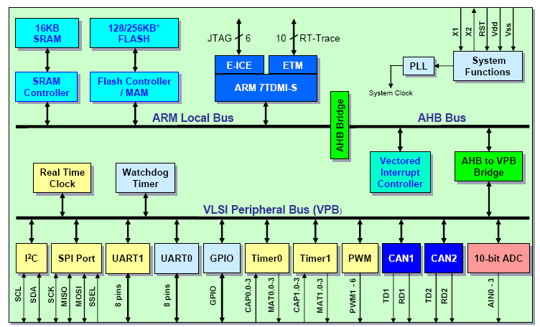
LPC21XX block diagram
Notes:
The LPC2119/2129/2194/2292/2294 are based on a 16/32 bit ARM7TDMI-STM CPU with real-time emulation and embedded
trace support, together with 128/256 kilobytes (kB) of embedded high speed flash memory. A 128-bit wide internal memory
interface and a unique accelerator architecture enable 32-bit code execution at maximum clock rate. For critical code size
applications, the alternative 16-bit Thumb Mode reduces code by more than 30% with minimal performance penalty.

Slide 7
Features of LPC 2129
16/32-bit ARM7TDMI-S microcontroller in a tiny LQFP64 package.
16 KB on-chip Static RAM.
128/256 KB on-chip Flash Program Memory.
In-System Programming (ISP) and In-Application Programming (IAP) via on-chip boot-loader software.
Notes:
QFP means Quad Flat package

Slide 8
Features of LPC 2129
Embedded ICE-RT interface enables breakpoints and watch points.
Embedded Trace Macro cell enables non-intrusive high speed real-time tracing of instruction execution.
Two CAN interfaces with advanced acceptance filters.
Four channel 10-bit A/D converter with conversion time as low as 2.44 ms.
Notes:
ICE means in circuit emulator
CAN-Control Area Network
EmbeddedICE-RT interface enables breakpoints and watch points. Interrupt service routines can continue to execute whilst
the foreground task is debugged with the on-chip RealMonitor software.
• Embedded Trace Macrocell enables non-intrusive high speed real-time tracing of instruction execution.

Slide 9
Features of LPC 2129
Two UARTs, Fast I2C (400 kbits/s) and two SPIs
60 MHz maximum CPU clock available from programmable on-chip
Phase-Locked Loop with settling time of 100 ms.
Vectored Interrupt Controller with configurable priorities and vector addresses.
Notes:
I2C-Inter integrated circuit
SPI-Serial peripheral interface

Slide 10
Features of LPC 2129
Two 32-bit timers, PWM unit (six outputs), Real Time Clock and Watchdog.
Up to forty-six 5 V tolerant general purpose I/O pins.
On-chip crystal oscillator with an operating range of 1 MHz to 30 MHz.
Notes:
PWM-Pulse width modulation
P0 having 30 pins and P1 16 pins

Slide 11
Features of LPC 2129
Two low power modes, Idle and Power-down.
Individual enable/disable of peripheral functions for power optimization.
Dual power supply:
CPU operating voltage range of 1.65 V to 1.95 V (1.8 V ±0.15 V).
I/O power supply range of 3.0 V to 3.6 V (3.3 V ± 10 %) with 5 V tolerant I/O pads.
Notes:
We will give two power supply's to the controller
In Idle mode,
execution of instructions is suspended until either a Reset or interrupt occurs. Peripheral functions continue operation during Idle
mode and may generate interrupts to cause the processor to resume execution. Idle mode eliminates power used by the
processor itself, memory systems and related controllers, and internal buses.
In Power Down mode, the oscillator is shut down and the chip receives no internal clocks. The processor state and registers,
peripheral registers, and internal SRAM values are preserved throughout Power Down mode and the logic levels of chip pins
remain static. The Power Down mode can be terminated and normal operation resumed by either a Reset or certain specific
interrupts that are able to function without clocks. Since all dynamic operation of the chip is suspended, Power Down mode
reduces chip power consumption to nearly zero.

Slide 12
Q 1
30
29
28
27
26
25
24
23
22
21
20
19
18
17
16
15
14
13
12
11
10
9
8
7
6
5
4
3
2
1
End
What is the bus used to communicate with RAM and ROM by the CPU in ARM
Common bus
AHB
VPB
ARM7 local bus
PurpleLeap Company Confidential
PurpleLeap Company Confidential
Notes:
Answer is ARM7 local bus

Slide 13
Crystal Oscillator
Oscillator modes: a) slave mode of operation, b) oscillation mode of operation, c) external crystal model
Notes:
Reset has two sources on the LPC2119/2129/2194/2292/2294: the RESET pin and Watchdog Reset. The RESET pin is a
Schmitt trigger input pin with an additional glitch filter. Assertion of chip Reset by any source starts the Wakeup Timer (see
Wakeup Timer description later in this chapter), causing reset to remain asserted until the external Reset is de-asserted, the
oscillator is running, a fixed number of clocks have passed, and the Flash controller has completed its initializa

Slide 14
Phase Locked Loop
10 to 25 MHz input clock frequency
Output frequency (10 MHz to the max). CPU rate(LPC2xxx: 60MHz)
Programmable frequency multiplication
PLL bypassed on reset
PLL lock indicator can be used as an interrupt to connect the PLL once it is locked.
Notes:
The PLL accepts an input clock frequency in the range of 10 MHz to 25 MHz only. The input frequency is multiplied up into the
cclk with the range of 10 MHz to 60 MHz using a Current Controlled Oscillator (CCO). The multiplier can be an integer value from
1 to 32 (in practice, the multiplier value cannot be higher than 6 on the LPC2119/2129/2194/2292/2294 due to the upper
frequency limit of the CPU). The CCO operates in the range of 156 MHz to 320 MHz, so there is an additional divider in the loop
to keep the CCO within its frequency range while the PLL is providing the desired output frequency. The output divider may be
set to divide by 2, 4, 8, or 16 to produce the output clock. Since the minimum output divider value is 2, it is insured that the PLL
output has a 50% duty cycle.

Slide 15
Phase Locked Loop
Notes:
PLL activation is controlled via the PLLCON register. The PLL multiplier and divider values are controlled by the PLLCFG register.
These two registers are protected in order to prevent accidental alteration of PLL parameters or deactivation of the PLL. Since
all chip operations, including the Watchdog Timer, are dependent on the PLL when it is providing the chip clock, accidental
changes to the PLL setup could result in unexpected behavior of the microcontroller. The protection is accomplished by a feed
sequence similar to that of the Watchdog Timer. Details are provided in the description of the PLLFEED register.

Slide 16
Phase Locked Loop
Notes:
The PLL is turned off and bypassed following a chip Reset and when by entering power Down mode. PLL is enabled by software
only. The program must configure and activate the PLL, wait for the PLL to Lock, then connect to the PLL as a clock source.

Slide 17
VPB DIVIDER
The VPB Divider determines the relationship between the processor clock (cclk) and the clock used by peripheral devices (pclk).
The VPB Divider serves two purposes. The first is to provides peripherals with desired pclk via VPB bus so that they can operate at the speed chosen for the ARM processor.
The second purpose of the VPB Divider is to allow power savings when an application does not require any peripherals to run at the full processor rate.
The VPB Divider is connected to the PLL output, the PLL remains active (if it was running) during Idle mode
Notes:
The VPB Divider determines the relationship between the processor clock (cclk) and the clock used by peripheral devices (pclk).
The VPB Divider serves two purposes. The first is to provides peripherals with desired pclk via VPB bus so that they can operate
at the speed chosen for the ARM processor. In order to achieve this, the VPB bus may be slowed down to one half or one fourth
of the processor clock rate. Because the VPB bus must work properly at power up (and its timing cannot be altered if it does not
work since the VPB divider control registers reside on the VPB bus), the default condition at reset is for the VPB bus to run at
one quarter speed. The second purpose of the VPB Divider is to allow power savings when an application does not require any
peripherals to run at the full processor rate.

Slide 18
VPB Divider Connections
Notes:
Because the VPB
Divider is connected to the PLL output, the PLL remains active (if it was running) during Idle mode.

Slide 19
Q 2
30
29
28
27
26
25
24
23
22
21
20
19
18
17
16
15
14
13
12
11
10
9
8
7
6
5
4
3
2
1
End
ARM7 follows how many stage pipelining?
A)1
B)3
C)4
D)2
PurpleLeap Company Confidential
PurpleLeap Company Confidential
Notes:
3 stage pipelining

Slide 20
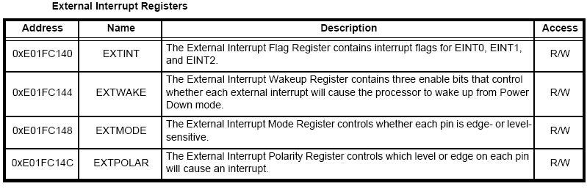
EXTERNAL INTERRUPT INPUTS
The external interrupt function has four registers associated with it.
EXTINT register contains the interrupt flags
EXTWAKEUP register contains bits that enable individual external interrupts to wake up from Power Down mode.
The EXTMODE and EXTPOLAR registers specify the level and edge sensitivity parameters.
Notes:
The LPC2119/2129/2194/2292/2294 includes four External Interrupt Inputs as selectable pin functions. The External Interrupt
Inputs can optionally be used to wake up the processor from the Power Down mode.
The external interrupt function has four registers associated with it. The EXTINT register contains the interrupt flags, and the
EXTWAKEUP register contains bits that enable individual external interrupts to wake up the LPC2119/2129/2292/2294 from
Power Down mode. The EXTMODE and EXTPOLAR registers specify the level and edge sensitivity parameters.

Slide 21
Pin Diagram
Notes:
LPC2129 Pin diagram.
Some pins having multiple functionalities so to select one functionality pin selection registers are used.

Slide 22
Pin description
Notes:
P0 pins

Slide 23
Pin description
Notes:
P0 pins

Slide 24
Pin description
Notes:
P0 pins

Slide 25
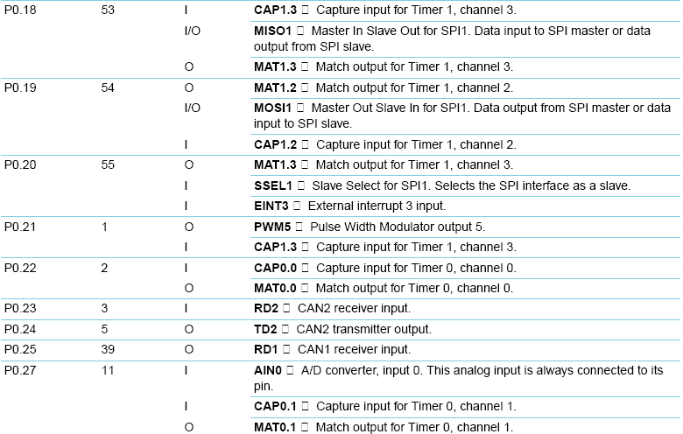
Pin description
Notes:
P0 pins

Slide 26
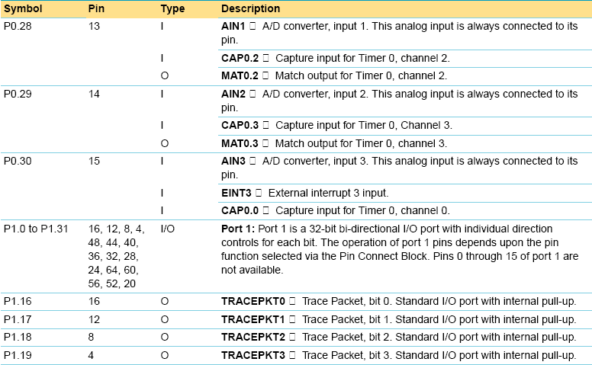
Pin description
Notes:
P0 and P1 pins

Slide 27
Pin description
Notes:
P1 pins

Slide 28
Pin description
Notes:
System control block pins

Slide 29
General Purpose I/O
Pins available for GPIO:
LPC21/22
– 48-pin devices: 32
– 64-pin devices: 46
– 144 pin devices: 76 (max.) (with external memory)
112 (w/o external memory)
Shared with
– Alternate functions of all peripherals
– Data/address bus and strobe signals for external memories
Notes:
GPIO in LPC2129.
46 GPIO pins in LPC2129 because the package is 64 QFP.

Slide 30
General Purpose I/O
Direction control of individual bits
Separate set and clear registers
Pin value and output register can be read separately
Slew rate controlled outputs (10 ns)
5 registers used to control I/Os
All I/O default to inputs after reset
Notes:
LPC2119/2129/2194 has two 32-bit General Purpose I/O ports. Total of 30 out of 32 pins are available on PORT0. PORT1 has
up to 16 pins available for GPIO functions. PORT0 and PORT1 are controlled via two groups.
Each pin we can select separately.

Slide 31
General Purpose I/O
Notes:
IOPIN:-GPIO Port Pin value register. The current state of the GPIO configured port pins can always be read from this register, regardless of pin direction and mode.
IOSET:-GPIO Port Output set register. This register controls the state of output pins in conjunction with the IOCLR
register. Writing ones produces highs at the corresponding port pins. Writing
zeroes has no effect.
IODIR:-GPIO Port Direction control register. This register individually controls the direction of each port pin.
IOCLR:-GPIO Port Output clear register. This register controls the state of output pins. Writing ones produces lows at the corresponding port pins and clears the corresponding bits in the IOSET register. Writing zeroes has no effect.
The purpose of the Pin Connect Block is to configure the microcontroller pins to the desired functions.
Conventional GPIO Implementation Drawbacks
Conventional ARM GPIO is implemented on the APB peripheral bus Toggling speed of the GPIO is limited due to the 3-stage pipeline, AHB bridge and the APB bus
Understanding the slow port behavior
It takes 5 clocks to execute a port write Total time from instruction fetch to port change is 7 clocks
Maximum achievable period is 14 clocks (cclk/14) = (60/14) = 4.28MHz

Slide 32
Q 3
30
29
28
27
26
25
24
23
22
21
20
19
18
17
16
15
14
13
12
11
10
9
8
7
6
5
4
3
2
1
End
How many GPIO pins does LPC have
A)44
B)46
C)48
D)32
PurpleLeap Company Confidential
PurpleLeap Company Confidential
Notes:
P0 having 30 and P1 having 16 totally 46

Slide 33
Pin Connect Block
Many on-chip functions can use I/O pins
Number of I/O-pins is limited
I/Os can be configured to adapt various functions
Configuration done by Pin Connect Block
Notes:
PINSEL0 and PINSEL1 registers are used for P0 pins and PINSEL2 for P1 pins.

Slide 34
Pin Connect Block
On reset all the I/O pins are configured as GPIO.
The secondary functions are selected through the PINSEL registers.
The EINT1 interrupt line shares the same I/O pin as GPIO 0.14 and a UART1 control line.
So, in order to use EINT1 we must configure the pin select register to switch from the GPIO function to EINT1.
Notes:
PINSEL0 and PINSEL1 registers are used for P0 pins and PINSEL2 for P1 pins.

Slide 35
Pin Connect Block
The Pin Control Module contains three registers
Pin function select register 0 (PINSEL0 - 0xE002C000)
Notes:
Pin connect block registers

Slide 36
Pin Connect Block
Notes:
Pin connect block registers

Slide 37
Pin Connect Block
Notes:
Pin connect block registers

Slide 38
Pin Connect Block
Notes:
Pin connect block registers

Slide 39
Pin function select register 1
(PINSEL1 - 0xE002C004)

Slide 40
Pin function select register 1 (PINSEL1 - 0xE002C004)
Notes:
Pin connect block registers

Slide 41
Pin function select register 1 (PINSEL1 - 0xE002C004)
Notes:
Pin connect block registers

Slide 42
Pin function select register 1 (PINSEL1 - 0xE002C004)
Notes:
Pin connect block registers

Slide 43
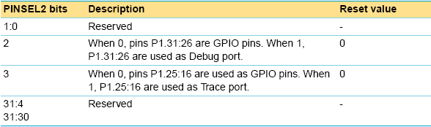
Pin function select register 2 (PINSEL2 - 0xE002C014)
Notes:
Pin connect block registers

Slide 44
Q 4
30
29
28
27
26
25
24
23
22
21
20
19
18
17
16
15
14
13
12
11
10
9
8
7
6
5
4
3
2
1
End
What is VPB ?
VLSI portable bus
B) Von Neumann peripheral bus
C) VLSI peripheral bus
D) VLSI pin bus
PurpleLeap Company Confidential
PurpleLeap Company Confidential

Slide 45


LED Programming
Circuit symbol
Notes:
Led programming example.
In this example we have to select output direction for the particular port to which you want to connect led.

Slide 46
Testing an LED
Never connect an LED directly to a battery or power supply!
It will be destroyed almost instantly because too much current will pass through and burn it out.
LEDs must have a resistor in series to limit the current to a safe value, for quick testing purposes a 1k resistor is suitable for most LEDs if your supply voltage is 12V or less.
Notes:
Led interfacing

Slide 47
Program to Toggle the LED
#include <LPC21xx.H>
int delay(void)
{
int j;
for(j=0;j<10000;j++);
return 0;
}
void main()
{
IODIR0=0x00000001;
while(1)
{
IOSET0=0x00000001;
delay();
IOCLR0=0x00000001;
delay();
}
}
Notes:
In this program we connected one led to P0.0.First we selected output direction for the particular port pin and making the led on or off by changing the port pin value using clear and set registers.

Slide 48
Further Reading/References
www.arm.com
LPC 2129 manual
PurpleLeap Company Confidential

Slide 49
Q&A
PurpleLeap Company Confidential

Slide 50
Summary
In this Session we have learnt how to
Program and configure GPIO
Program LED.
PurpleLeap Company Confidential
PurpleLeap Company Confidential

Slide 51
Quizzes & Assignments
PurpleLeap Company Confidential
PurpleLeap Company Confidential
Notes:
You may want to add forum topics, if any.

Slide 52
Assignment Walkthrough
PurpleLeap Company Confidential
PurpleLeap Company Confidential
Notes:
You may want to add forum topics, if any.

Slide 53
What’s coming up?
In the next session, you will learn about Interfacing of
LCD and
Stepper Motor
PurpleLeap Company Confidential
Notes:
Tell the students upfront whats coming up in the next session so that they can be prepared for it.

Slide 54
Feedback
30
29
28
27
26
25
24
23
22
21
20
19
18
17
16
15
14
13
12
11
10
9
8
7
6
5
4
3
2
1
End
1. How do you rate this session?
Excellent
Good
Satisfactory
Poor
PurpleLeap Company Confidential
PurpleLeap Company Confidential

